Slide 1
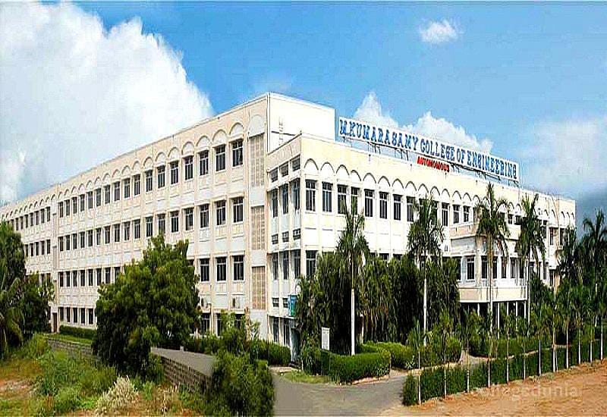

Slide 2
DESIGN AND FABRICATION OF SOLAR OPERATED WEEDER MACHINE
GUIDED BY:
Dr . N. PARTHIPAN
TEAM:
P .GUGAN [927622BME024]
S .KARTHI [927622BME305]
H .MOHAMED FAIZAL [927622BME052]

Slide 3
COMPONENTS:
1. HIGH POWER MOTOR (BRUSHLESS DC MOTOR)
2. CONNECTOR ARMS
3. MOUNTS AND JOINTS
4. SCREWS
5. WHEELS AND RODS
6. SOLAR
7. BATTERY
8. HANDLES TO HOLD THE WEEDER
9. CULTIVATION BLADE
10. DESIGN CALCULATIONS

Slide 4
INTRODUCTION:
Weed control is one of the most difficult tasks in agriculture that accounts for a considerable share of the cost involved in agriculture production. Farmers generally expressed their concern for the effective weed control measures to arrest the growth and propagation of weeds

Slide 5
PROBLEM IDENTIFICATION
: Weed removal is one of the major activities in agriculture. Chemical method of weed control is more prominent than manual and mechanical methods. However, its adverse effects on the environment are making farmers to consider and accept mechanical methods of weed control. Chemical weeding is the most extensively used method of weed removal But these chemicals used for weeding are harmful to living organisms and toxic in nature.

Slide 6
MOTIVATION AND OBJECTIVE
: The objective of the project is to design, construct and test solar operated weeder, to provide the best opportunity to farmer’s to easily control and removing the weed from farm. Weeding with the use of tools like cutlass and hoe requires high labour force in a commercial farming system hence mechanical weeder is necessary to reduce the labour force

Slide 7
EXISTING METHOD
: Agriculture is the backbone of India, and weed removal being one of the primary process in the field, there is a necessity for weed to be removed in all the fields to increase the quality of crops and to decrease the effect of weeds on crops. A weed may be defined as any plant or vegetation that interferes with the objectives of farming or forestry, such as growing crops, grazing animals or cultivating forest plantations

Slide 8
WORKING OF WEEDER MACHINE:
1. Initially start the motor with the help of on/off switch mounted on handle. We used the wiper motor.
2. The blades are used for the forward movement of the machine.
3. Battery is used to transmit power from motor to intermediate shaft.
4. The blades are mounted on the front side of the machine. When blades start rotating forward motion occurs.
5. Hence weeding is done with less effort and less cost

Slide 9
FUTURE SCOPE
: . If we use new material then performance will be high. 2. The farmers need alternatives for weed control due to the desire to reduce chemical use and production costs. 3. Currently no such system exists for removing weeds located in the seed line between crop plants.

Slide 10
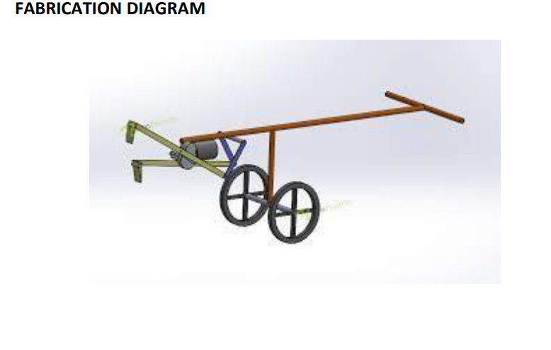

Slide 11
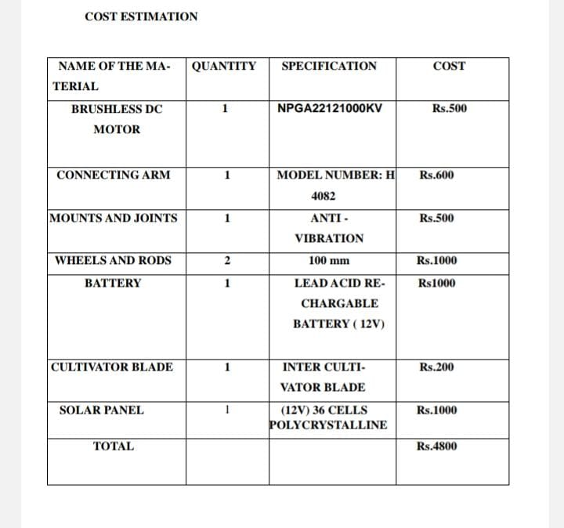

Slide 12


